Slide 1
Closing the cluster

Slide 2
What is “closing the cluster”?
Last step for the team and supervisor before leaving the cluster
Supervisor
receives all remaining questionnaires from team
Runs report checking data all collected for completeness
The team must resolve all remaining problems before leaving the cluster
When there are no issues remaining the system will archive the data and automatically upload to the Central Office

Slide 3
Closing cluster : requirements
Level | Requirement
Cluster level | All listed households visited (either complete interview or result code 2-9)
Household questionnaire | All interviews finalized (no partial cases)
Woman’s / Man’s questionnaire | All eligible individuals visited: either complete interview or result code 2-7. All interviews finalized
Biomarkers | Entries recorded for all eligible individuals
 | Random remeasurement completed and entered
 | Transmittal sheet entered by supervisor
 | All barcodes recorded in questionnaires present in transmittal sheet

Slide 4
Steps to close the cluster
# | Step
1 | All interviewers ensure they have completed questionnaires for all assigned households All eligible members within the household Biomarker questionnaires all entered
2 | Supervisor receives data from all members of their team
3 | Supervisor completes scanning of barcodes from the transmittal sheet
4 | If applicable, remeasurement completed and remeasurement form entered by supervisor
5 | Supervisor runs report using option 6: Close/list cluster
6 | Address any issues with duplicate cases first
7 | Resolve any outstanding messages
8 | Send updated data from interviewer tablets back to supervisor tablet
9 | Run option 6 report again
10 | Repeat steps 6-9 until no more messages

Slide 5
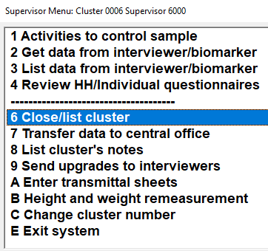
Closing clusters listing
Supervisor chooses option 6 from main menu:
Listing will show three parts:
Error message numbers – help find in manual
Error messages – brief description of problem
Household listing – a list of all households and women and their results codes

Slide 6
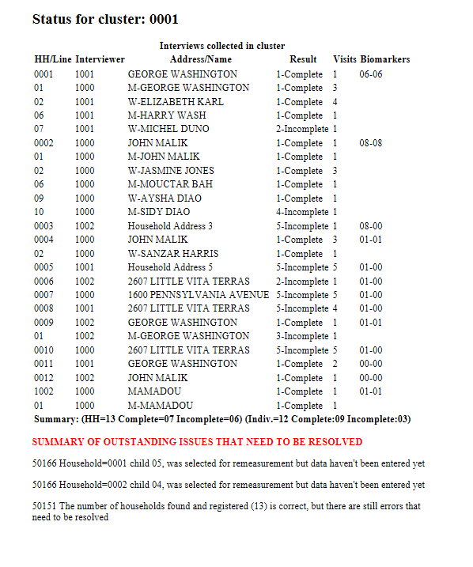
Closing clusters listing
Household listing
Error message numbers
Error messages
1
3
2
Notes:
Supervisor will something that looks like this…

Slide 7
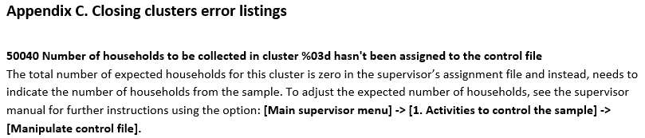
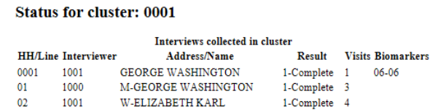
Resolve errors…
Identify error number and find it in the Supervisor Manual (Appendix C)
Identify which interviewer(s) has the problem
Household 0001 has error, belongs to interviewer 1001
Notes:
Find which interviewer has the error by finding the household in the listing and seeing which interviewer did it…

Slide 8
Resolve errors…
Refer to Supervisor Manual (Appendix C) for instructions to resolve
Interviewer resends data to supervisor
Supervisor attempts again to close cluster – determine if error was resolved
Now for some common errors…............

Slide 9
Fixing problems
Questionnaires not completed
Instruct the interviewer to return to the household and complete the interview
If the interview cannot be completed, enter the cover sheet and record the reason why the interview could not be done
Questionnaires that are partially saved
Check the interview on the interviewers machine, use the go-to-end button “>>|” to try to go the end of the questionnaire and save the data
If there are questions remaining, instruct the interviewer to return to the household to complete it.
Bar code inconsistencies –
Bar code present in questionnaire, not in transmittal sheet
Write bar code manually in transmittal sheet and enter in tablet
Bar code present in transmittal sheet but not in biomarkers questionnaire
Check paper questionnaire
Warn interviewer not to repeat problem

Slide 10
Examples of common messages
50055 Household partially completed, structure will not be checked at this time
To resolve: open interview on interviewer tablet, use option “>>|” go to End, then finalize. Send again to supervisor
50220 Household woman hasn't been contacted for individual interview
To resolve: check if interview can be completed, if so, conduct interview, and finalize. If woman can’t be interviewed, enter the cover sheet for that case and enter the appropriate result code 2-7
Send again to supervisor
Notes:
Have teams find this error in the superv manual. Have someone read it to the class. Have someone else explain what to do….

Slide 11
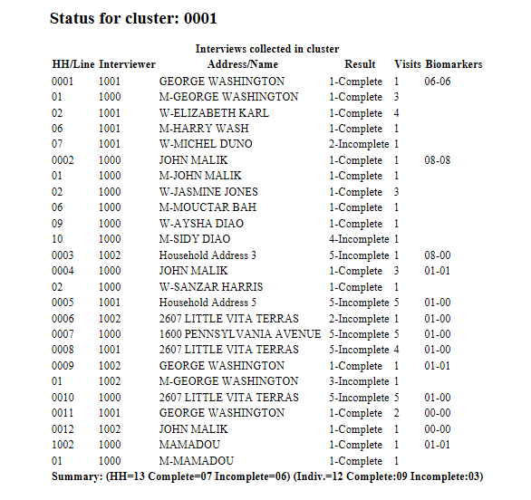
Closing Cluster
Are all errors resolved? See a listing like this?
If all errors resolved, then only the household listing remains
Notes:
Close the listing….

Slide 12
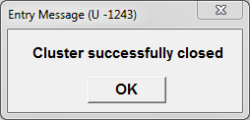

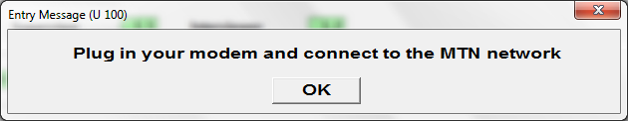
Closing Cluster
Cluster closed – bravo!
Supervisor
Internet via modem
Connect to the internet…
Central Office

Slide 13
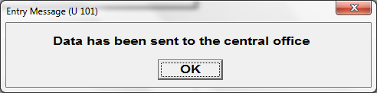
Closing Cluster
… can now move to next cluster…

